Slide 1

Depression and social interactions in cities and rural areas in Europe
Tamar Edry and Reetta Välimäki
2.4.2019

Slide 2
Research question
Is there a correlation between depressive symptoms and social interactions in different countries in Europe?
Does this correlation vary depending on the rural or urban areas?
Hypothesis:
There is a negative correlation between depressive symptoms and social interactions
In cities there are more social interactions and therefore less depressive symptoms

Slide 3
Data
From Eurostat country scale rural vs urban
Current depressive symptoms between cities and rural areas in different countries
How often people get together between cities and rural areas

Slide 4
Methods
Social interactions and depression
Data exploration between the variables
Regression between countries
A ratio between the two for each country
Possibly a comparison between two regression models (rural model and urban model)

Slide 5
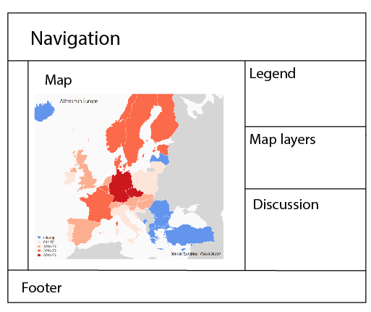
Sketch
Would include hovering information box for each country
Possibility to choose the variables at the map layers –box
It could also include the regression models between variables
Discussion would show the correlations between variables chosen

Slide 6
Challenges
The data is from national sources, no uniform template
Cities might have higher accessibility to healthcare
Might increase diagnosis
Might help with care

Slide 7

Literature
Dye, C. (2008). Health and Urban Living. Science, 319(5864), pp.766-769.
Gruebner, O., Rapp, M., Adli, M., Kluge, U., Galea, S. and Heinz, A. (2017). Cities and Mental Health. Deutsches Aerzteblatt Online.
Vlahov, D., Freudenberg, N., Proietti, F., Ompad, D., Quinn, A., Nandi, V. and Galea, S. (2007). Urban as a Determinant of Health. Journal of Urban Health, 84(S1), pp.16-26.

Slide 8
Thank you

